Slide 1
Unit testing
In ceedling

Slide 2
Table of contents
Introduction
What is Unit Testing?
Benefits
Tools
Demonstration
Questions?
Resources

Slide 3
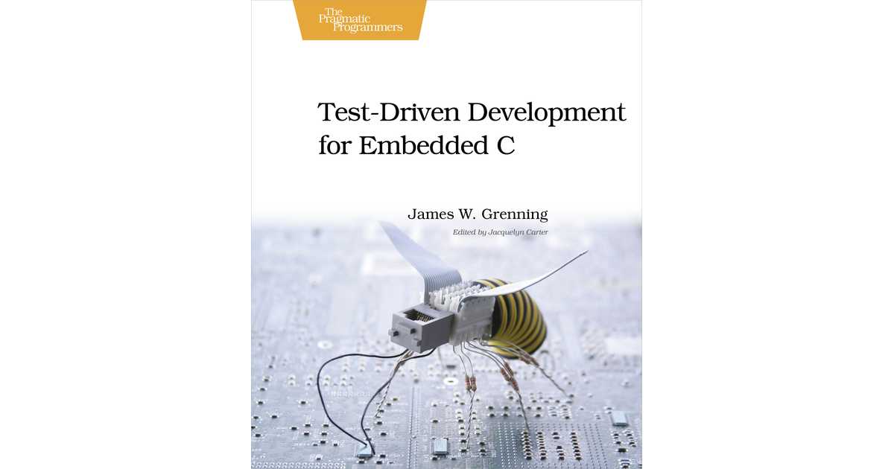
Introduction
Topics
Expectations
Notes:
What am I going to talk about?
I will introduce the concept of unit testing in embedded systems using the ceedling framework. This presentation includes a practical demonstration on an embedded platform, in this case esp-idf. I will briefly mention 3 testing types and where unit testing fits in. I have asked Alexey to buy a book on unit testing in embedded systems, this can be used as a great learning tool or reference manual for those interested. Please keep questions for the end.
What can you expect?
By the end of this demonstration you should be familiar with what unit tests are and how ceedling can be embedded in a project. I do not expect anyone to be able to start unit testing right away, but being aware of what is available, with a demonstration and additionally some literature for future reference should be more than enough to get anyone started.
If interested I’ll make this presentation available afterwards including the examples for reference

Slide 4
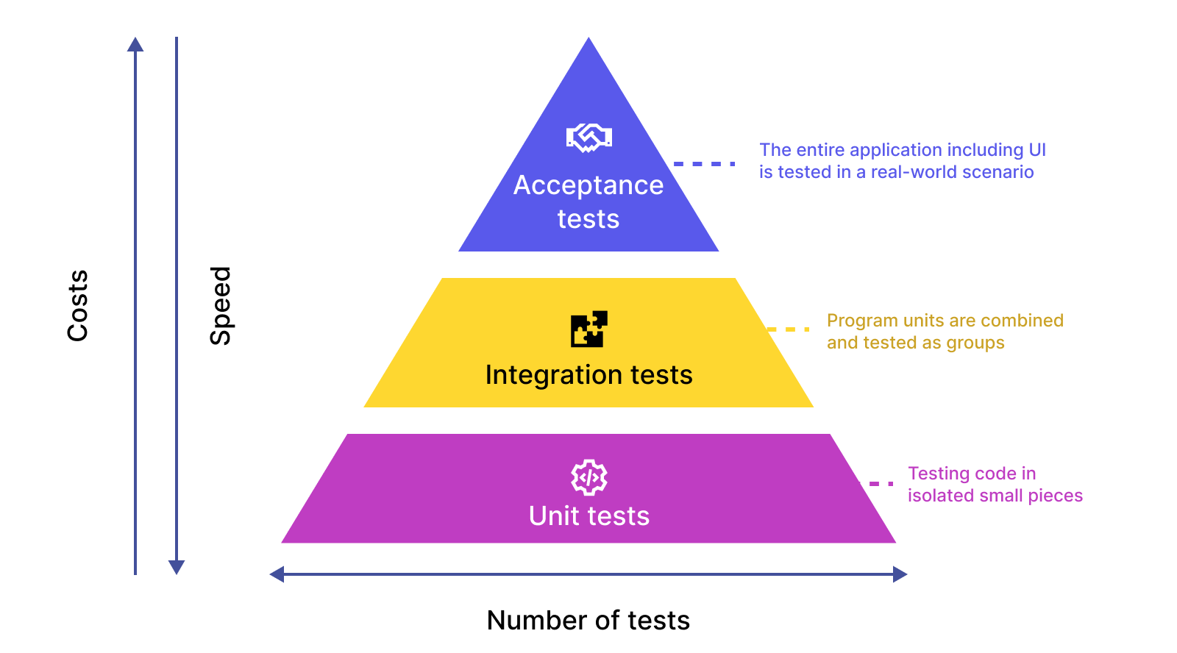
What is Unit Testing?
Isolated test from whole
Single unit
Comparison
Notes:
In unit testing we isolate a single unit which we put under test. Similar to having a device under test, we can have a single module under test.
When I say single unit, I mean a module. Modules should be responsible for the smallest scope possible. Some examples are a UART driver which should only be responsible for UART and a PID controller which should only be responsible for PID control.
There are several types and subtypes of tests, but I want to mention the following to put unit tests in their respectful place:
Acceptance test – A finished product will be tested to see if it behaves as expected when the target audience uses the device.
Integration test – Several modules have been combined to create a system, their interaction is verified.
Unit test – Testing of individual modules to ensure their single responsibility is satisfied.

Slide 5
Benefits
Positive
Proven tested
Workflow better thought through
Better maintainability
Better code structure
Documentation source
Easy handover
Less bugs
Negative
Test framework learning curve
Mindset learning curve
Not all tests are created equal
Notes:
There are several upsides and downsides to including unit testing in projects. The main issue around unit testing lies in the initial investment of effort. After that, the engineer only needs to worry about which modules make sense to be tested.
In summary: Unit testing forces us to consider best practices and testability. Starting from this perspective results in less bugs and easier to maintain code. As a bonus, the tests serve as documentation which is very easily shared and handed over.

Slide 6
Tools
Ceedling
GCC
GCOV
GCOVR
Install ceedling
Embed in repository
Start unit testing
Run tests
Verify results
Notes:
This demo focuses on using the ceedling framework to test C code. Other languages may require other testing frameworks.
To use ceedling, follow the following process

Slide 7
Demonstration
Test repository (esp project)
Brief introduction to structure
Test code
Test output and code coverage
Notes:
I’m going to show a test repository I made in which I implemented a PID controller to control an LED. I will mention what is relevant in the context of the unit and what we will be testing. Then I am going to show the unit test framework. I will briefly mention the structure and follow with showing the test code.
Finally I will run the code and show the output as well as the code coverage report.

Slide 8
Questions?

Slide 9
Resources
Book:
Test-Driven Development for Embedded C by James W. Grenning
Github Repository:
https://github.com/SoftwareShenzheneer/UnitTestDemo.git

